Slide 1

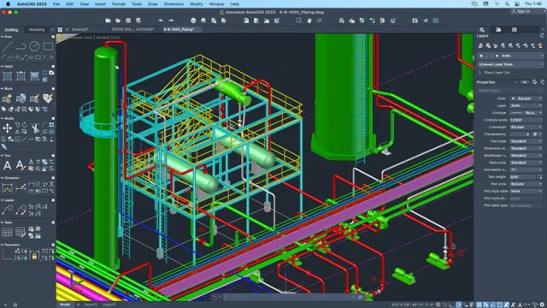
Engineering Design and Drawing
CHE103

Slide 2
Modify the Objects in AutoCAD

Slide 3
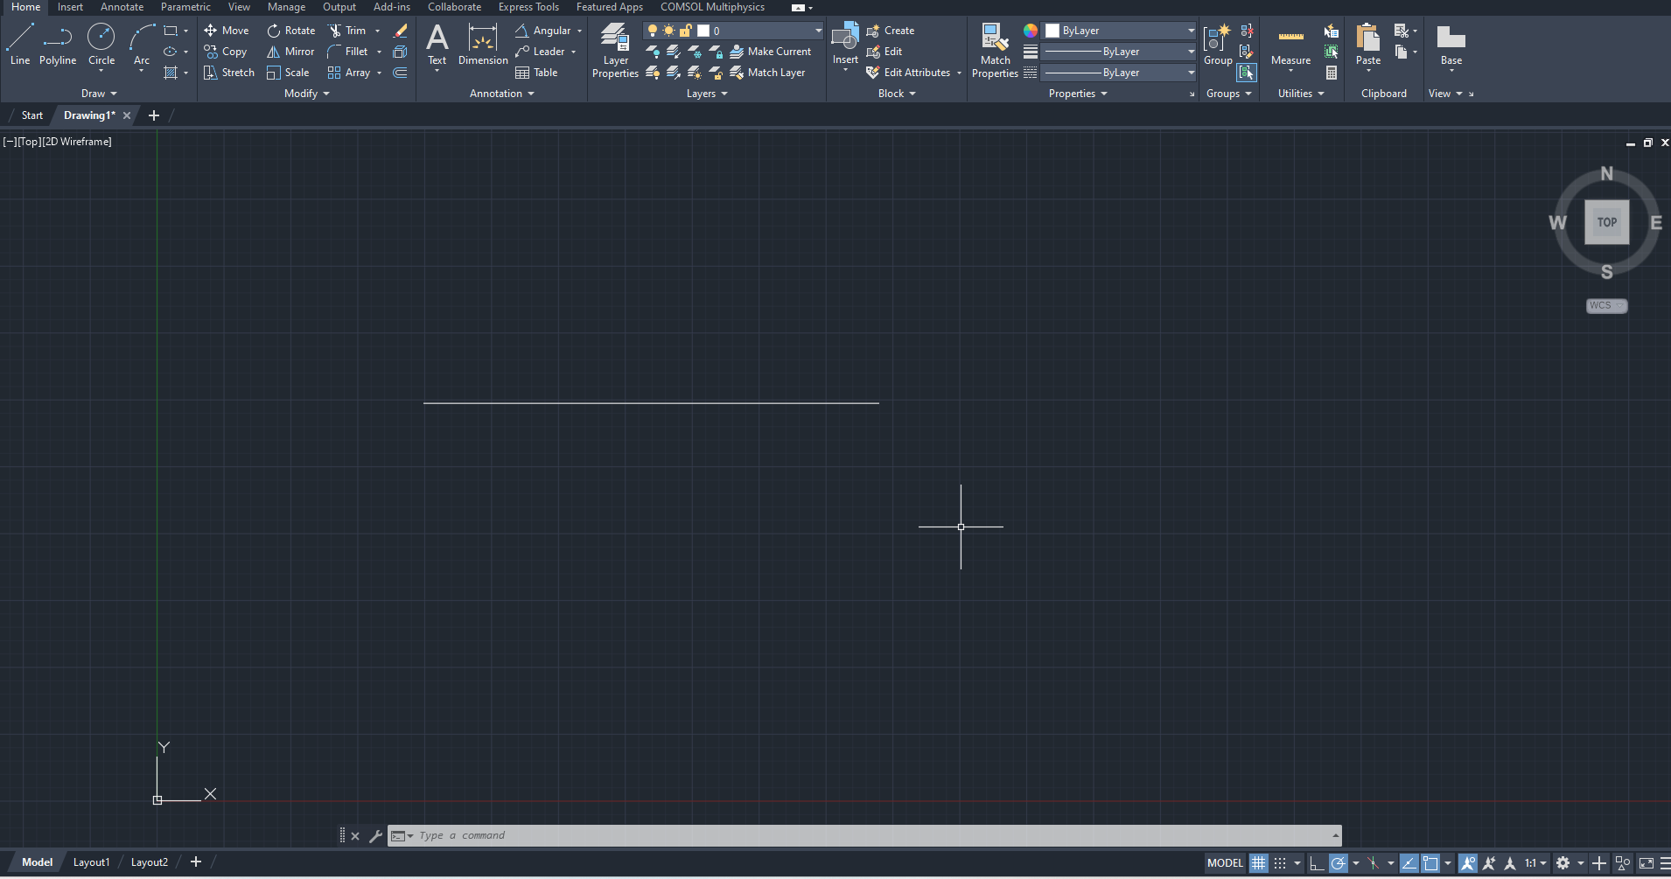
Modifying the objects

Slide 4

Select the move
Click on the object and press enter and move the object

Slide 5

Create some objects to learn copy

Slide 6
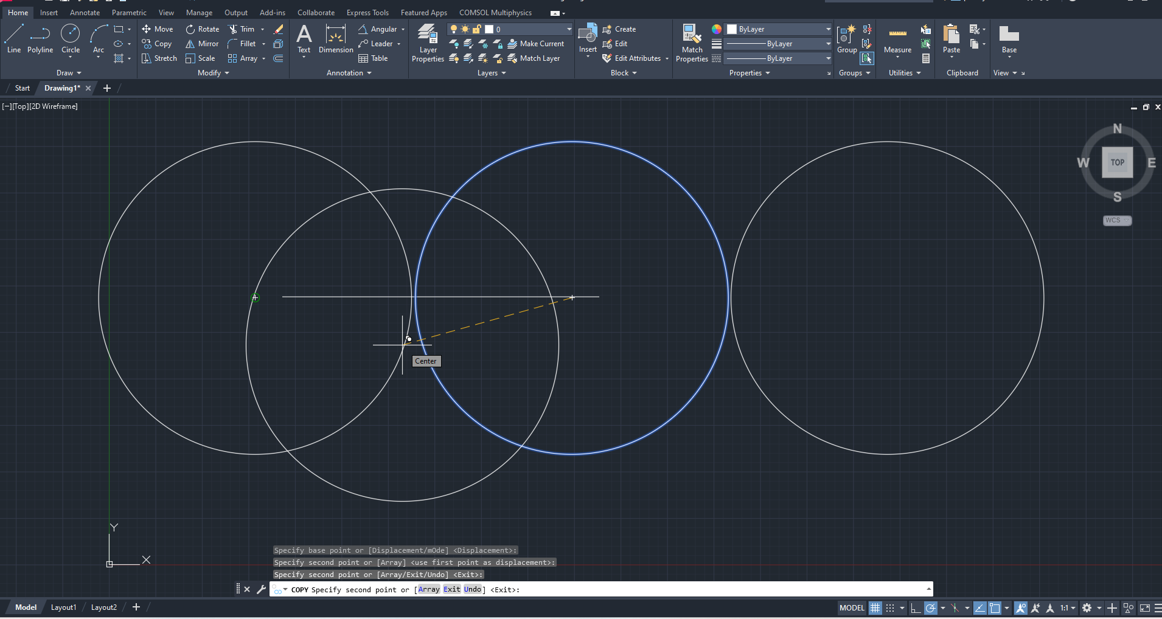
Press the copy then press enter and select object and click on screen to copy

Slide 7

Create some objects to learn rotate

Slide 8

Click on the rotate button and then select the object
Press enter and select the point of rotation, and rotate at specific angle.

Slide 9

Click on the rotate button and then select the object
Press enter and select the point of rotation, and rotate at specific angle.

Slide 10

Draw some objects to create mirror image

Slide 11

create a line for mirror

Slide 12

Select the mirror option and then select the object and click enter.
Click on the line so that It will create mirror image and press enter
It will create mirror image

Slide 13


Slide 14

Fillet is used to create round corner of specific diameter

Slide 15

To use fillet, press fillet then presses enter and write the radius and press enter.
Click two points between fillets need to create. Press the enter key.

Slide 16
Do some practice of fillets

Slide 17

Draw some objects crossing each other

Slide 18

Select the trim option and press enter
Click on the extended line/curve to trim it and press enter.

Slide 19

Do some practice of trimming the objects.

Slide 20

Offset is used to create a copy with a lower or higher dimension object of the selected object.

Slide 21

Select the Offset and then write the dimension of object in command
select the object and click outside the object to create copy outside
Click inside the object to copy inside the selected object.

Slide 22

Do some practice with offsets

Slide 23

Create some objects to learn “Erase”

Slide 24

Click on the object and then click on erase to delete the object

Slide 25

The selected object will be deleted.

Slide 26
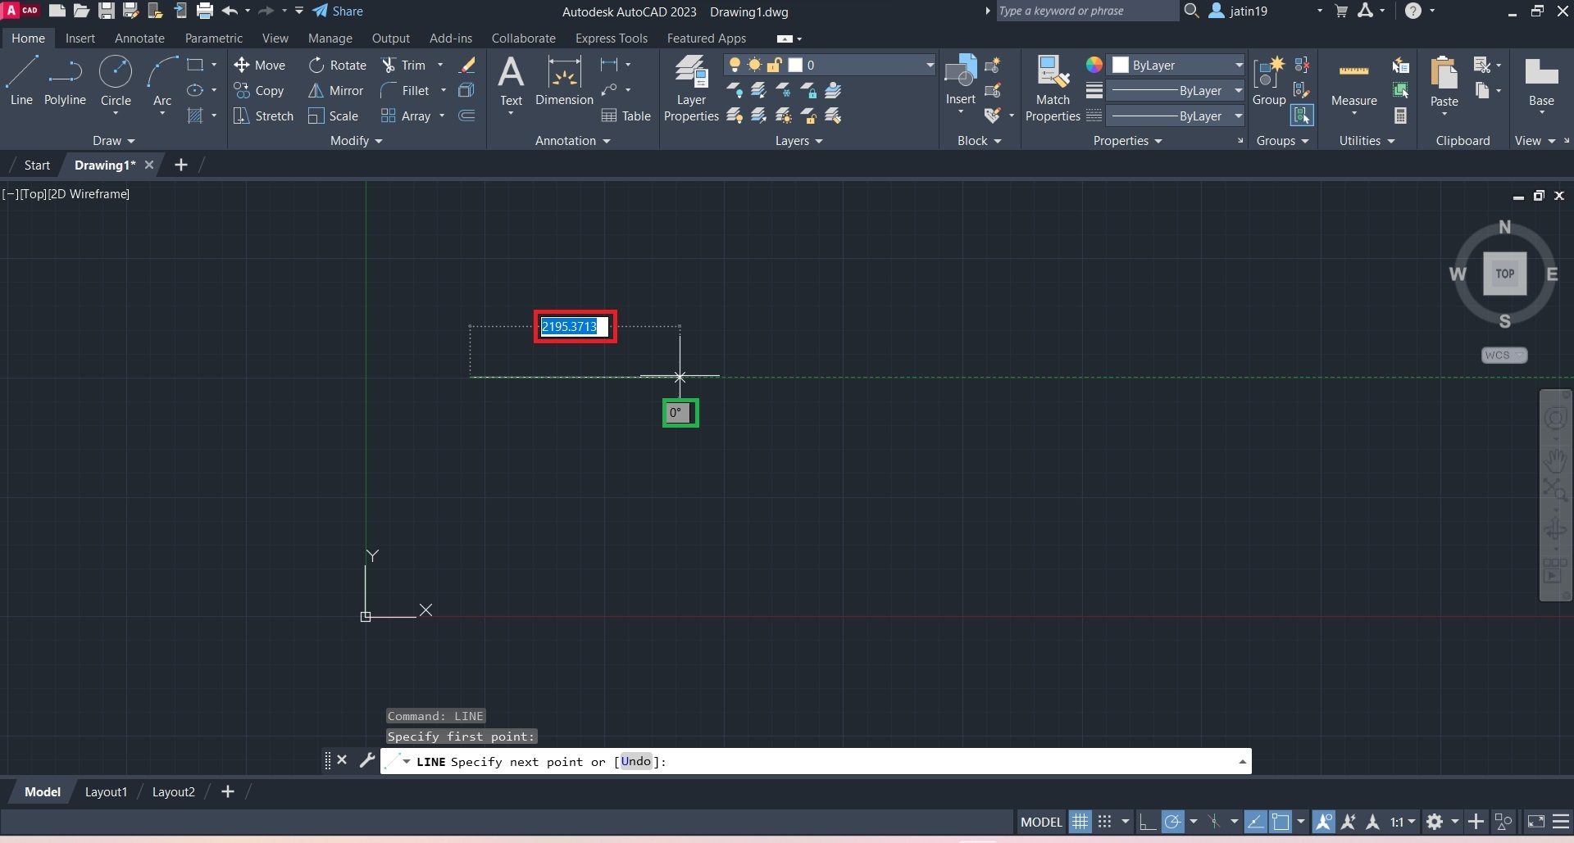
Entering the dimensions for a line
The red box is where you will enter the length of the line, and the green box indicates the angle the line makes with the x axis.

Slide 27
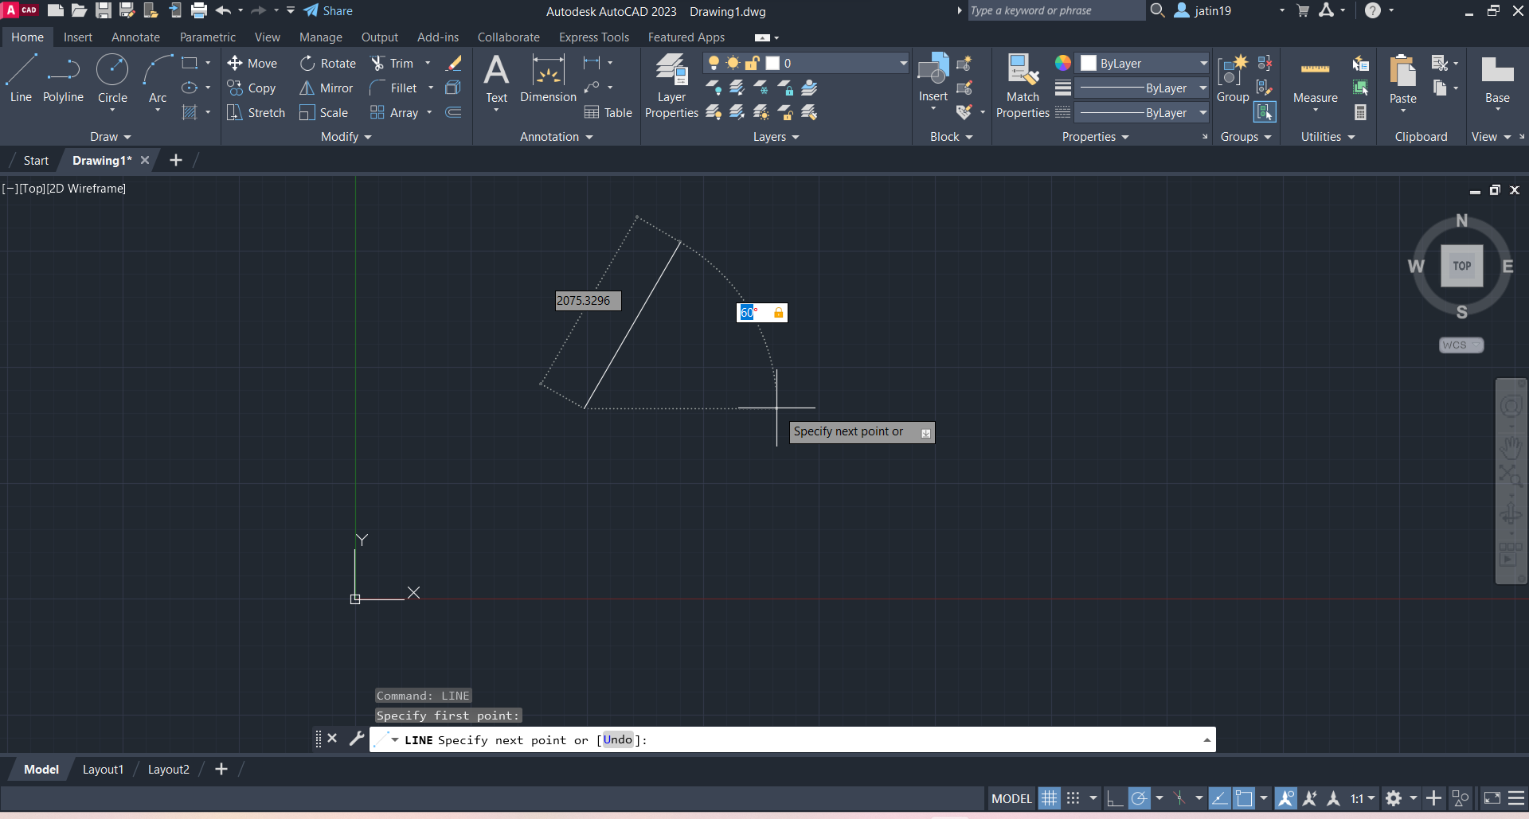
Press tab to switch to angle, now enter your angle (60 deg in this case).

Slide 28

Press tab again to switch back to length, and enter the required length of the line (200 here). Now press enter to make the line with length 200 and angle 60 deg.

Slide 29
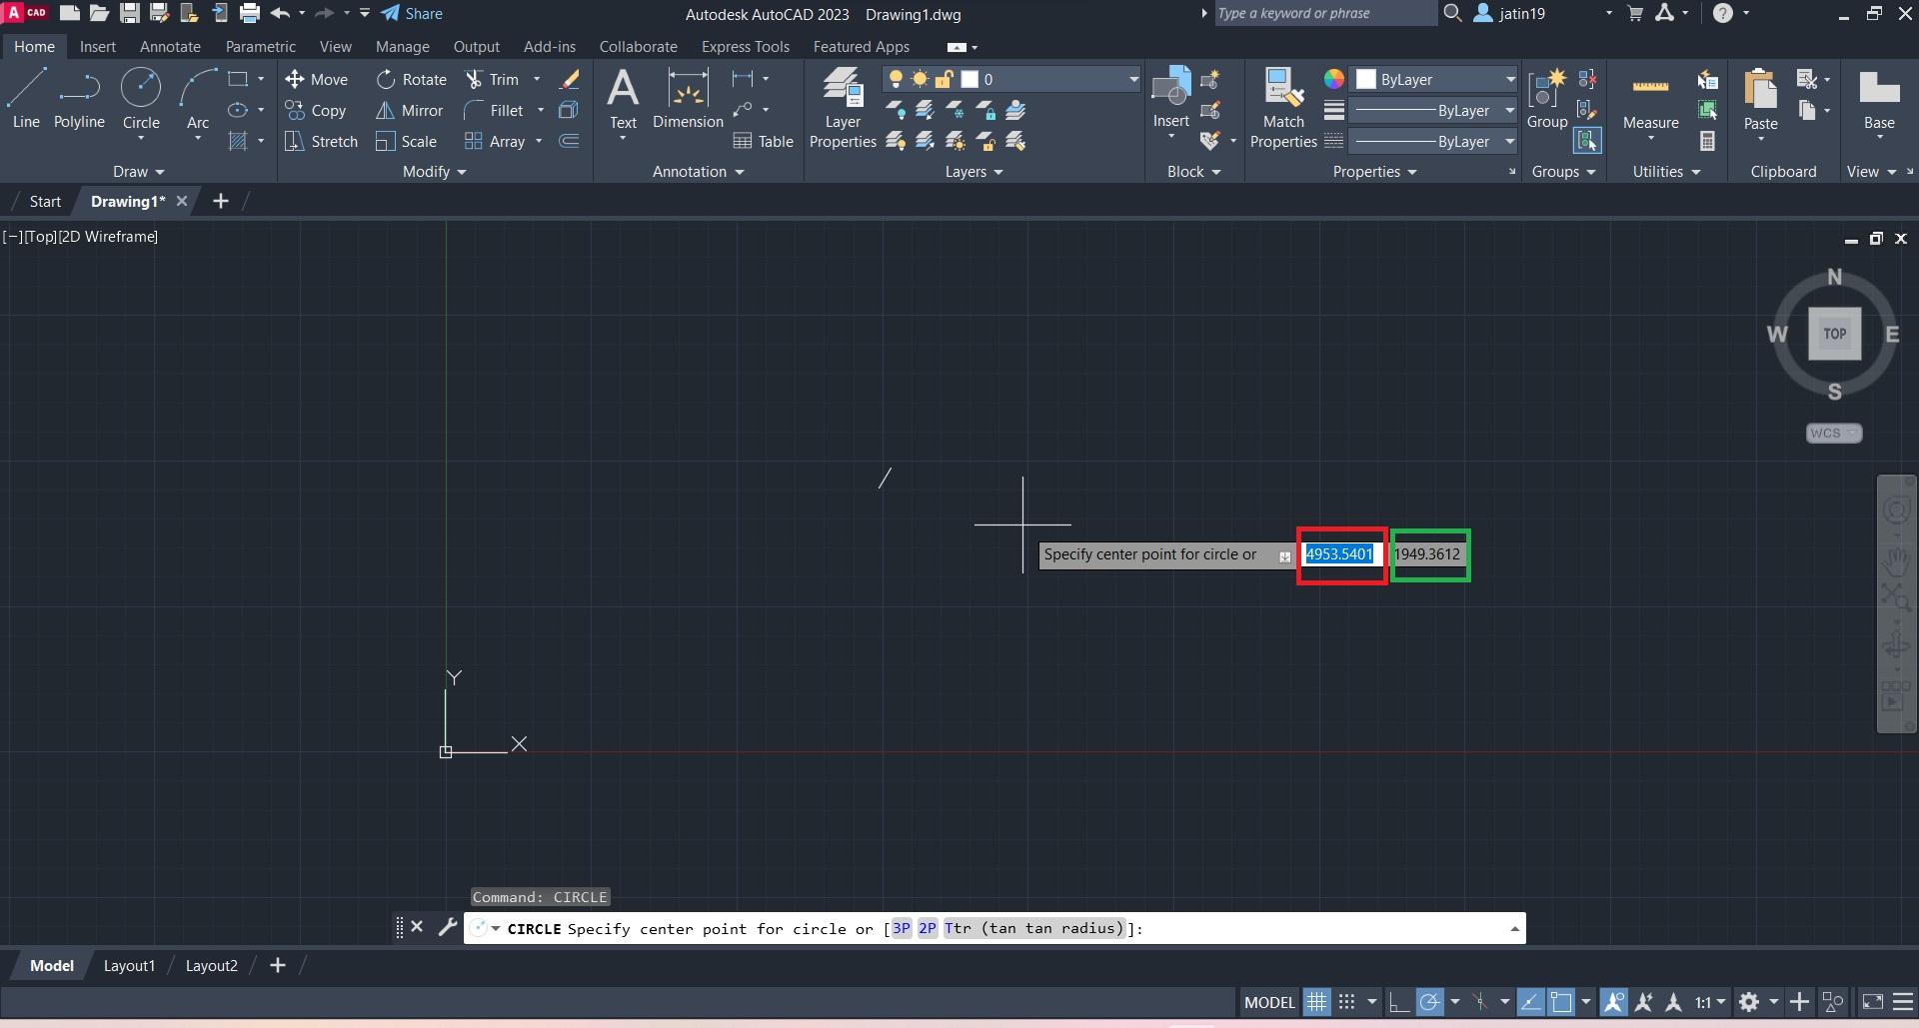
Entering dimensions for a circle
Select circle from the draw panel, you will get an interface like this. The red box is the x coordinate and green box is the y coordinate of the centre of the circle. Press tab to switch between them and enter your desired x and y values, when done press enter to fix the centre of the circle

Slide 30
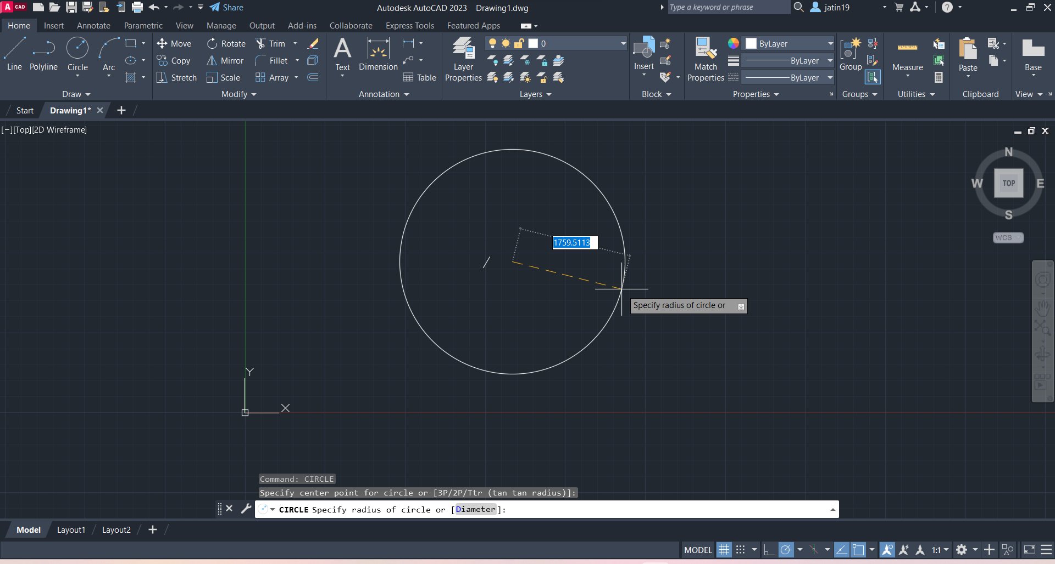
After selecting the centre of the circle, you will then set the radius of the circle, the highlighted value in the above image is the projected radius of the circle, you can enter the value of the radius that you want. Now press enter to create the desired circle.

Slide 31
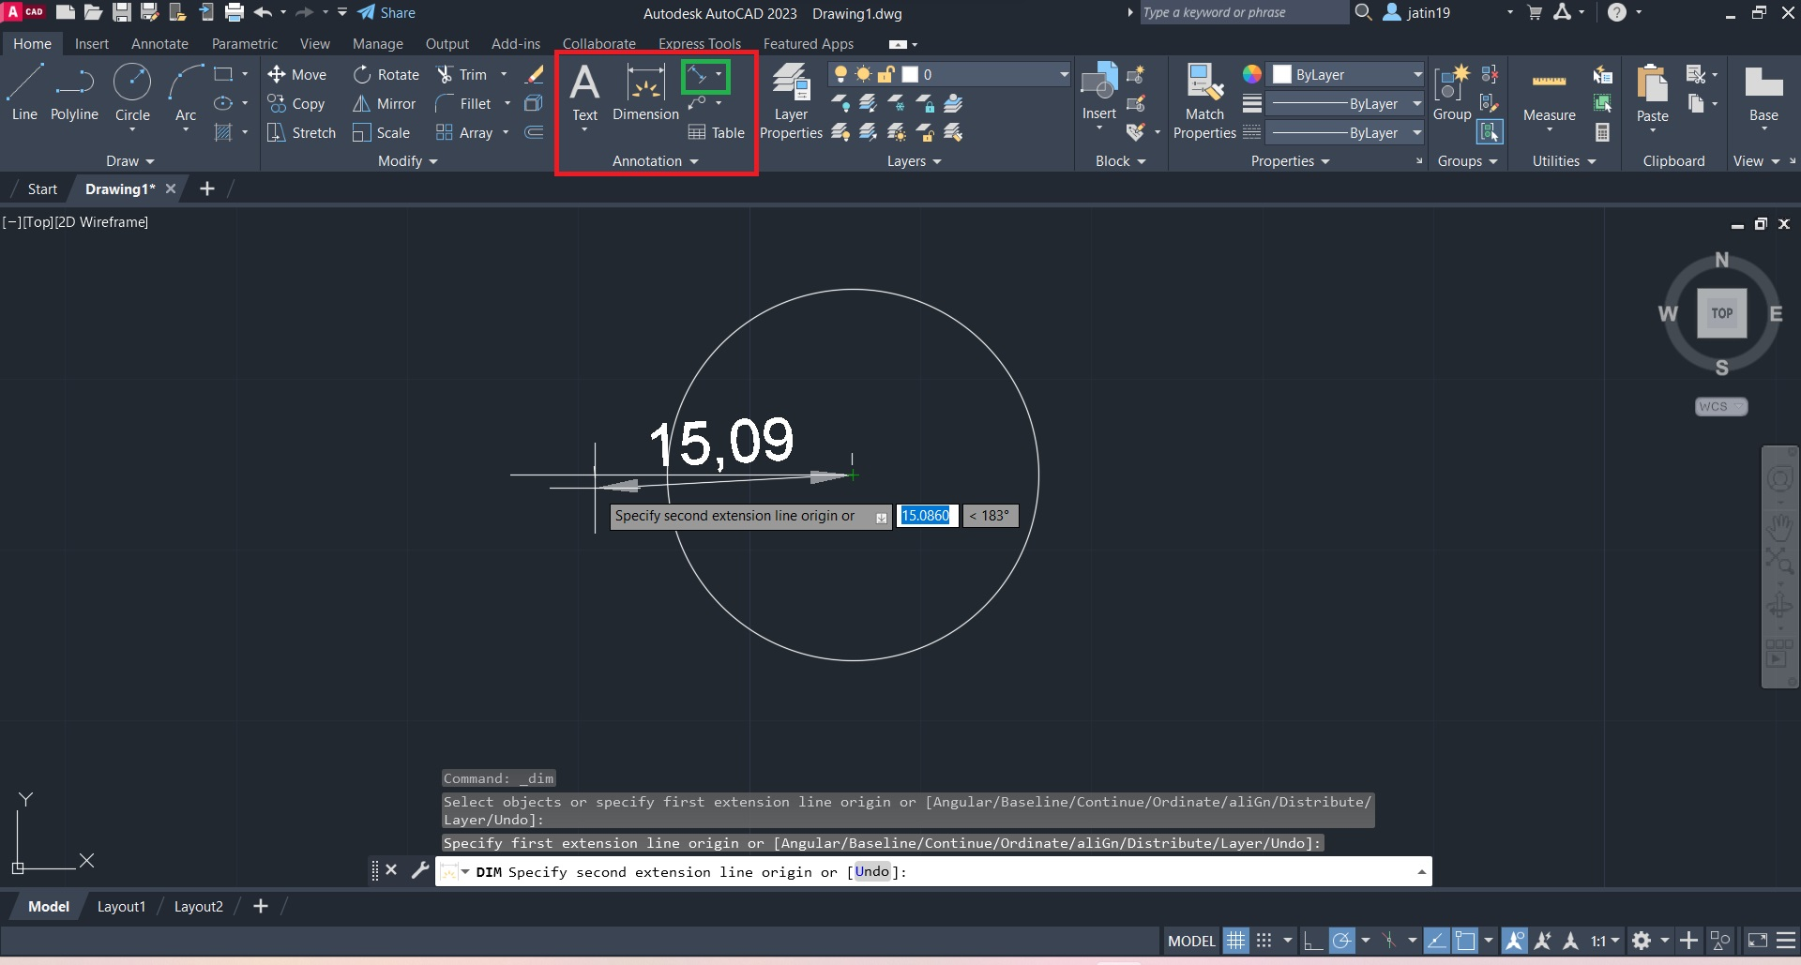
Entering dimension labels in your drawing
The red box depicts the annotation panel, click on the icon highlighted by green, which by default is used to add labels for a line. After clicking the icon you will be asked to select the start and end points of the line for which the label is to be added. Select the points of the line.

Slide 32
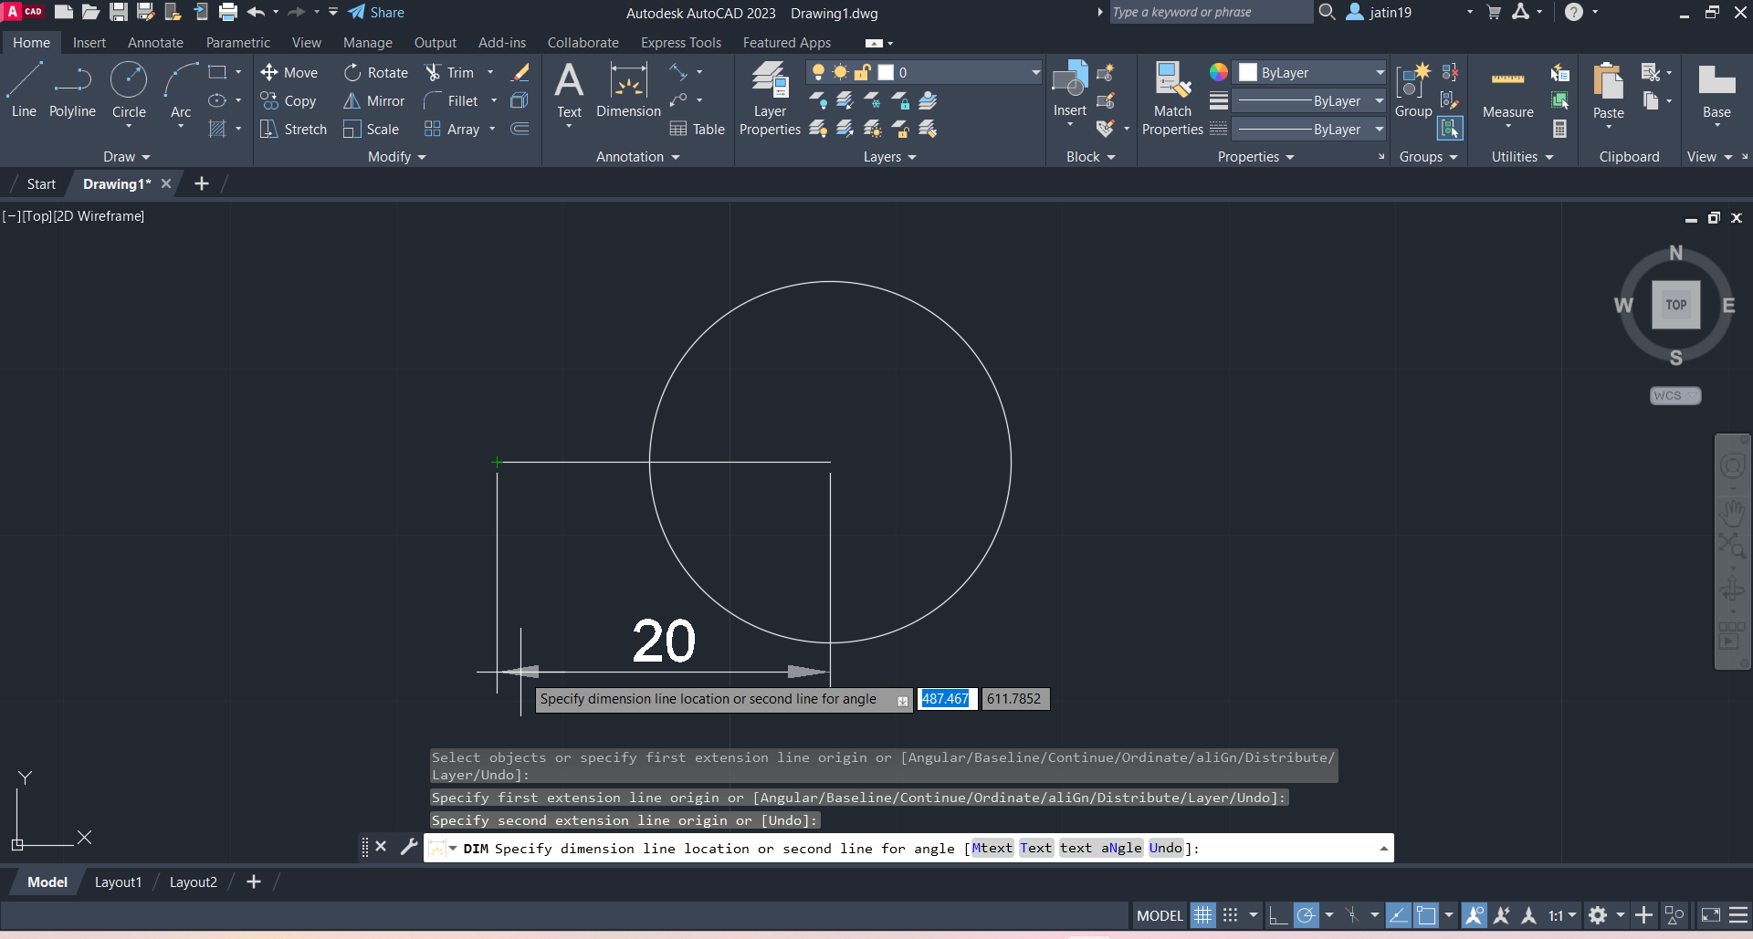
After selecting the points, it will display the length of the line, now you can drag the label according to your preference and when ready press the enter key to place the label.

Slide 33
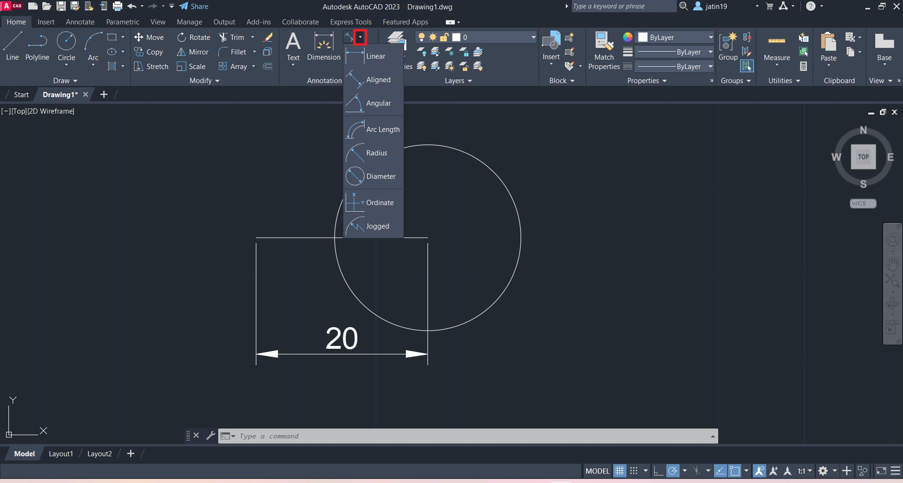
Click the highlighted arrow to switch the labels for different shapes, for our next case we will select the radius for the circle.

Slide 34
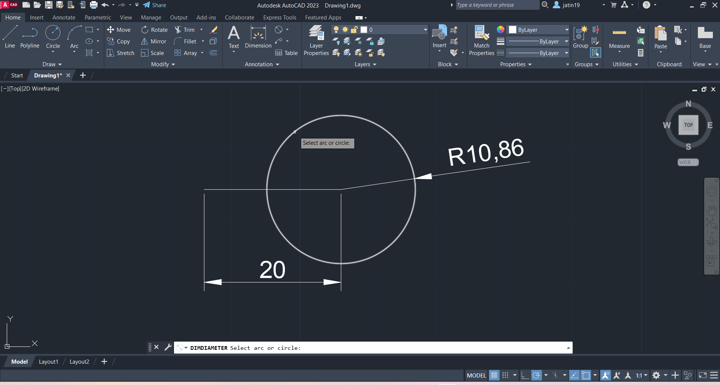
After selecting the radius option from the drop down menu, you will be asked to select the circle for which the radius is to be labelled. Click on the circle and it will show its radius. And just like for a line you can move the label around according to your preference and when done press enter to add the label

Slide 35
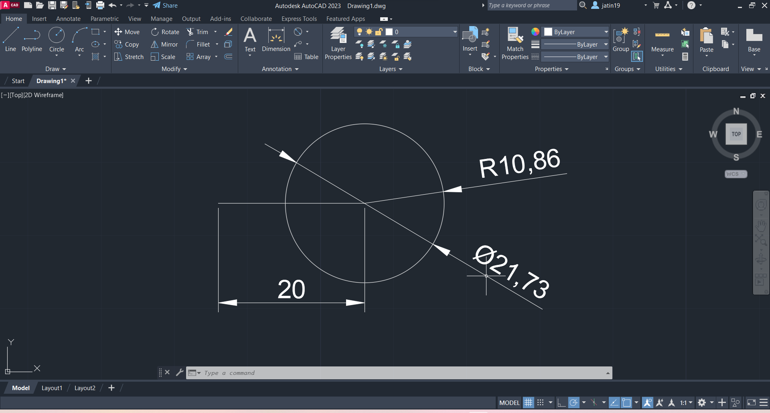
You can also add the label of diameter instead of the radius for a circle, for this just select the diameter option from the drop down menu of the dimensions icon and then follow the same steps as we did for labelling the radius, but in this case you will get a different label, which you can see in the above image.

